Slide 1
OpenShift 4.x Architecture Workshop
CoreOS and OpenShift 4.x
July 2019

Slide 2

CoreOS

Slide 3

Container Host Vision
An Ideal Container Host would be | Red Hat CoreOS
Minimal | Only what’s needed to run containers
Secure | Read-only & locked down
Immutable | Immutable image-based deployments & updates
Always up-to-date | OS updates are automated and transparent
Updates never break my apps | Isolates all applications as containers
Updates never break my cluster | OS components are compatible with the cluster
Supported on my infra of choice | Inherits majority of the RHEL ecosystem
Simple to configure | Installer generated configuration
Effortless to manage | Managed by Kubernetes Operators

Slide 4
Red Hat CoreOS
Adapting for the next wave of innovation in distributed systems
Combining the innovations of Container Linux and Atomic with the stability and ecosystem of RHEL
Fully integrated and delivered via OpenShift.
Small footprint, derived from RHEL
~400 packages
Fast provisioning: clusters deploy in minutes
Simplified, cluster-centric updates and upgrades
Managed and automated via operators

Slide 5
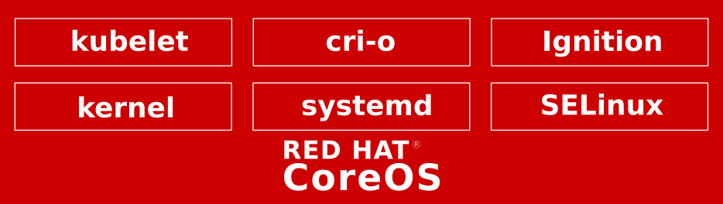
Red Hat CoreOS
Built for stability, scale, and hands-free operation
Full support for the RHEL ABI & container ecosystem
An immutable host, delivered and managed via OpenShift
Aligned lifecycle and release cadence
Updates & upgrades deployed via operators
UX inspired by Container Linux
Read-only OS binaries in /usr
Integrated container & kubernetes stack
One-touch provisioning with Ignition
App / Service
RHEL ABI

Slide 6
One Touch provisioning via Ignition
Machine generated; machine validated
Ignition applies a declarative node configuration early in the boot process.
Generated via openshift-install
Similar in scope to cloud-init
Configures storage, systemd units, users, & remote configs
Executed in the initramfs
v3.0 spec is in progress
{ "ignition": { "config": {}, "timeouts": {}, "version": "2.1.0" }, "passwd": { "users": [ { "name": "core", "passwordHash": "$6$43y3tkl...", "sshAuthorizedKeys": [ "key1" ] } ] }, "storage": {}, "systemd": {} }

Slide 7
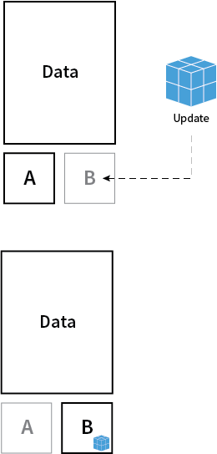
Transactional Updates via rpm-ostree
Versioning and Simplifying OS Updates
Transactional updates ensure that the Red Hat CoreOS is never altered during runtime. Rather it is booted directly into an always “known good” version.
Each OS update is versioned and tested as an complete image.
OS binaries (/usr) are read-only
Updates encapsulated in container images
file system and package layering available for hotfixes and debugging

Slide 8
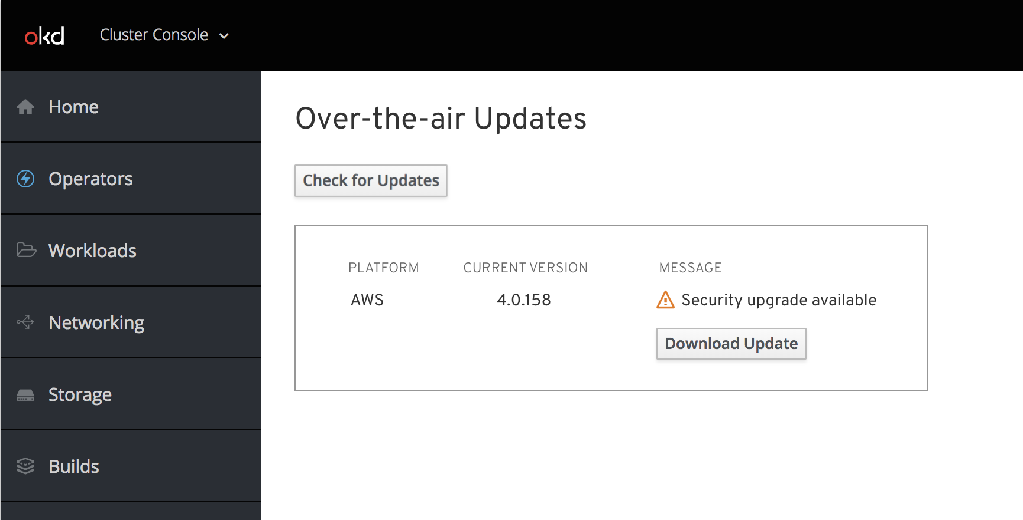
Over-the-air Updates - Delivery Mechanism
For Hosted and on-prem Deployments
Updates can be driven from either cloud.openshift.com and/or the Cluster Console
Updates are delivered via OCI images
Auto-update support
Manual updates will be supported for disconnected environments
Tooling to automate updates will be added in later release
Single source of content to mirror

Slide 9

Low-level Debugging via Toolbox
Bring your tools with you!
Toolbox is a simple script that provides a persistent privileged container for the following use cases:
Low-level troubleshooting /debugging environment
Collecting sosreports
Install additional utilities not available as part of RHCOS
Toolbox shell
Red Hat CoreOS

Slide 10



Container Stack
OCI tooling to create, run, and manage, Linux Containers with a cluster-friendly life cycle
skopeo
Light-weight runtime for the Kube CRI
A docker-compatible CLI for containers
Inspect, push/pull, & signing of OCI images
OCI compliant and docker compatible
Leverages runC
CLI via crictl
Improved performance and scalability
Remote management API via Varlink
Image/container tagging
Advanced namespace isolation
Inspect image manifests
Can transfer images between multiple registries.

Slide 11
OpenShift 4.x

Slide 12



OPENSHIFT 4.x THEMES
DAY 2
OPERATIONS
IMMUTABLE
INFRASTRUCTURE
OPERATOR
FRAMEWORK
Integrate CoreOS technology for a better install, re-config and upgrade experience.
Bring over-the-air upgrades to the platform.
Introduce Red Hat CoreOS as an immutable OS option. Enhance “infrastructure as code” throughout the platform.
Provide tools, guidance and automation for customers and partners to deliver smart software on top of OpenShift

Slide 13
OPENSHIFT 4.x WORKSTREAMS
DAY 2
OPERATIONS
IMMUTABLE
INFRASTRUCTURE
OPERATOR
FRAMEWORK
AWS Installer + bootstrapping
Autoscale out of the box
MachineSet node pools
Red Hat CoreOS
Discourage SSH/node mutation
Ignition for Machine config

Slide 14


IMMUTABLE INFRASTRUCTURE
OPENSHIFT 3
OPENSHIFT PLATFORM
Manually provision RHEL, bring to cluster
Rely on admin to correctly configure OS
Configuration drift over time
Upgrades control the platform and limited parts of the node
OPERATING SYSTEM

Slide 15


IMMUTABLE INFRASTRUCTURE
OPENSHIFT 3
OPENSHIFT 4
OPENSHIFT PLATFORM
CONTROL PLANE
OPERATING SYSTEM
OPERATING SYSTEM

Slide 16
IMMUTABLE INFRASTRUCTURE
CONTROL PLANE
For Day 2 management, the cluster needs full control over the nodes.
OPERATING SYSTEM

Slide 17
IMMUTABLE INFRASTRUCTURE
CONTROL PLANE
For Day 2 management, the cluster needs full control over the nodes.
=
Immutability
repeatability
=
Immutability
auditability
OPERATING SYSTEM

Slide 18
IMMUTABLE INFRASTRUCTURE
CONTROL PLANE
For Day 2 management, the cluster needs full control over the nodes.
=
Immutability
repeatability
=
Immutability
auditability
OPERATING SYSTEM
≠
Immutability
static clusters
≠
Immutability
no config changes

Slide 19

OPENSHIFT 4.x THEMES
DAY 2
OPERATIONS
IMMUTABLE
INFRASTRUCTURE

Slide 20
INFRASTRUCTURE PROVISIONING
 | OpenShift 3 | OpenShift 4
User Provisioned Infrastructure | Default | Optional
Installer Provisioned Infrastructure | not possible | Default

Slide 21
MACHINE CONFIGURATION
Red Hat CoreOS uses Ignition for configuration
Ignition only runs once, on the first boot
Ignition runs before systemd starts
Configure networking
Provision disks/RAID
{
ignition
profile
}
+
Applied at first boot
{
ignition
profile
}

Slide 22
CLUSTER API OBJECTS
New API objects to declaratively manage the cluster
MachineDeployment
MachineSet
Machine
MachineDeployment
type=worker
MachineSet
Zone1
MachineSet
Zone2

Slide 23
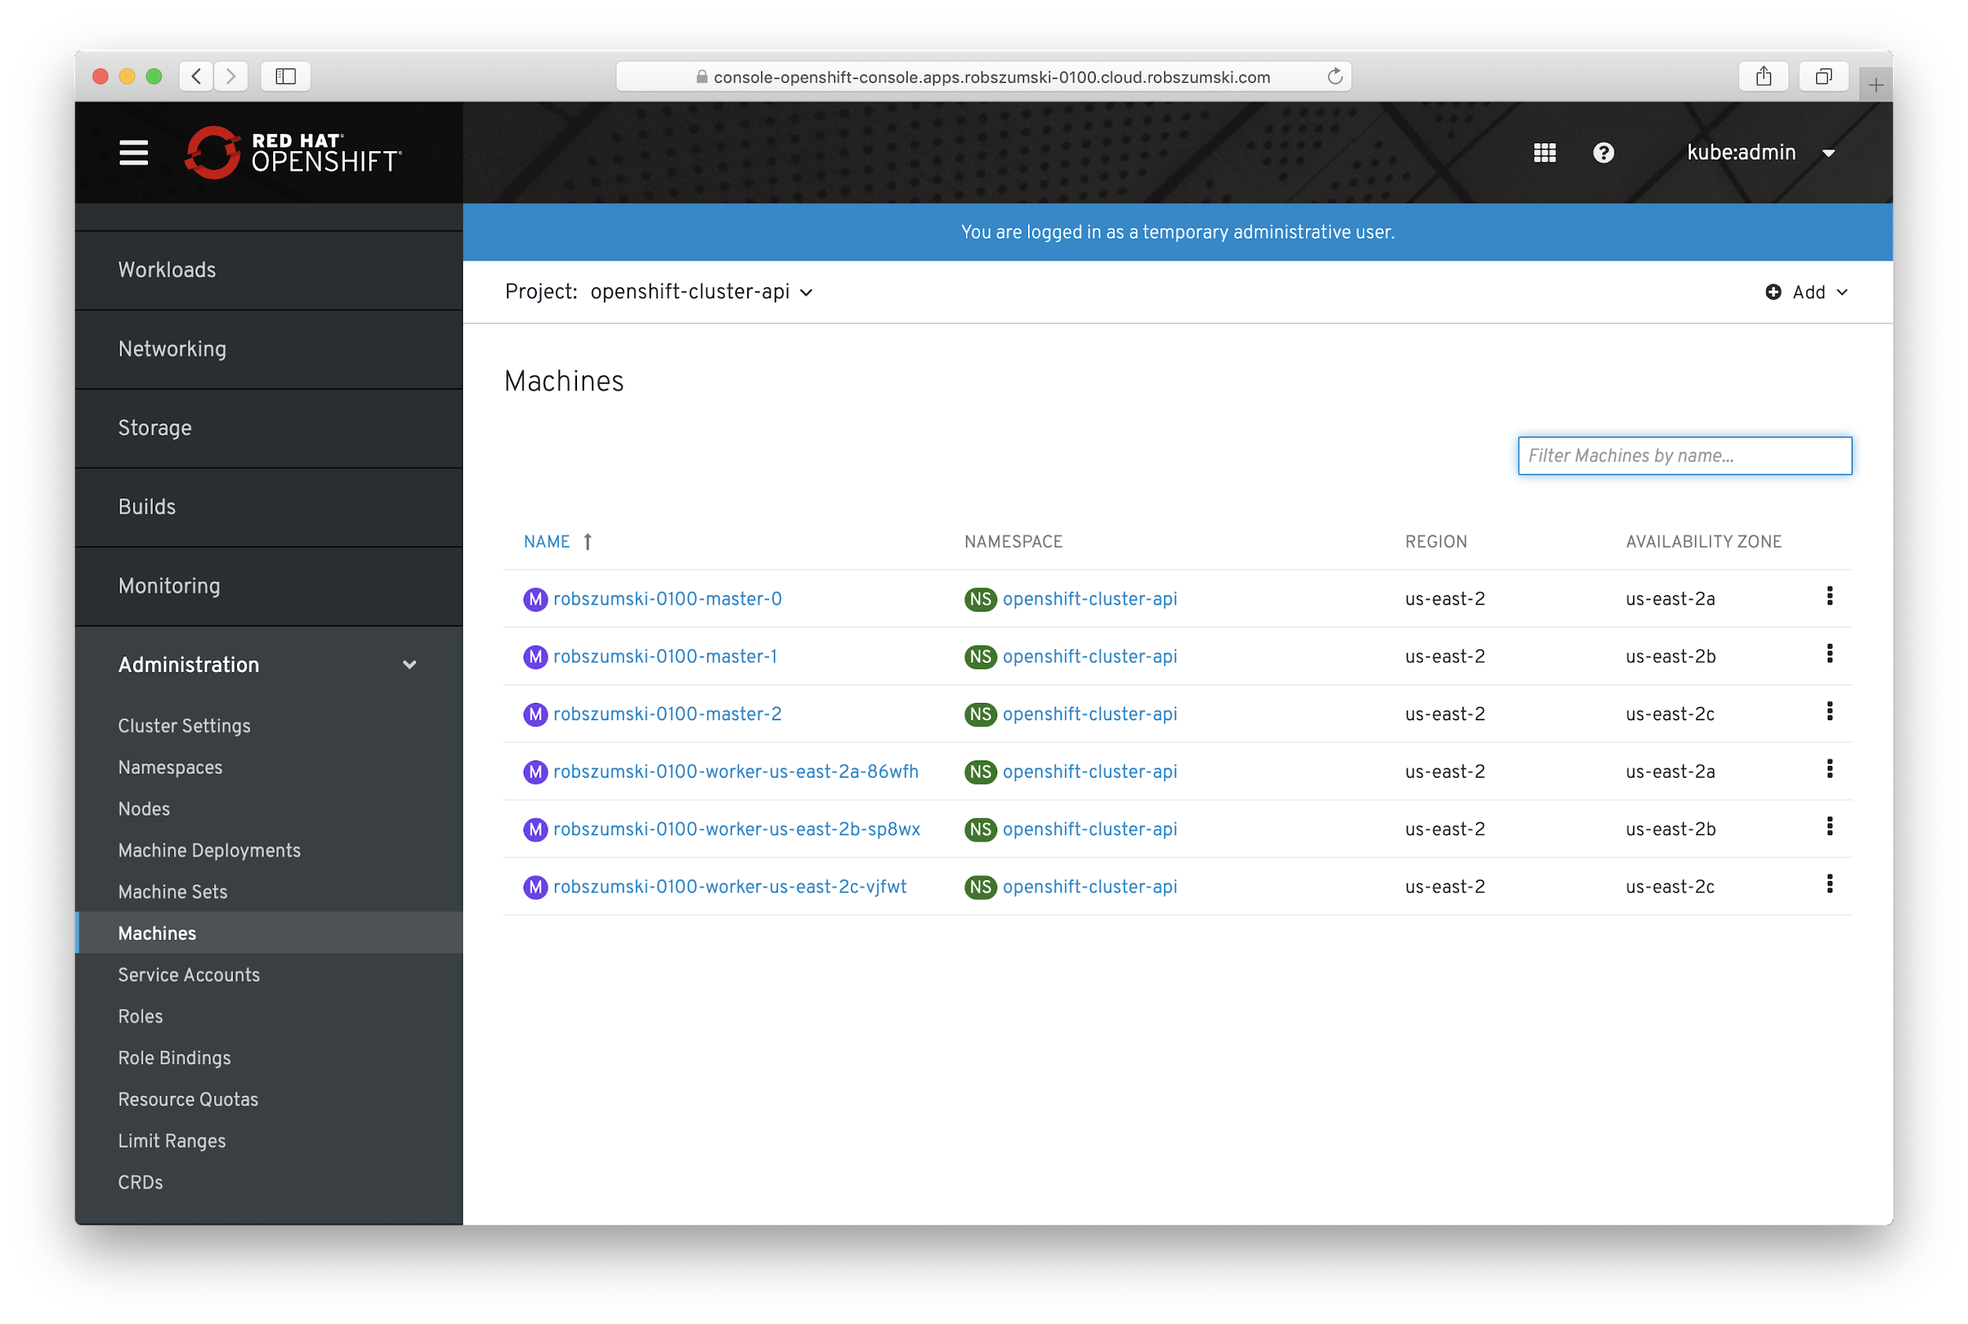

Slide 24
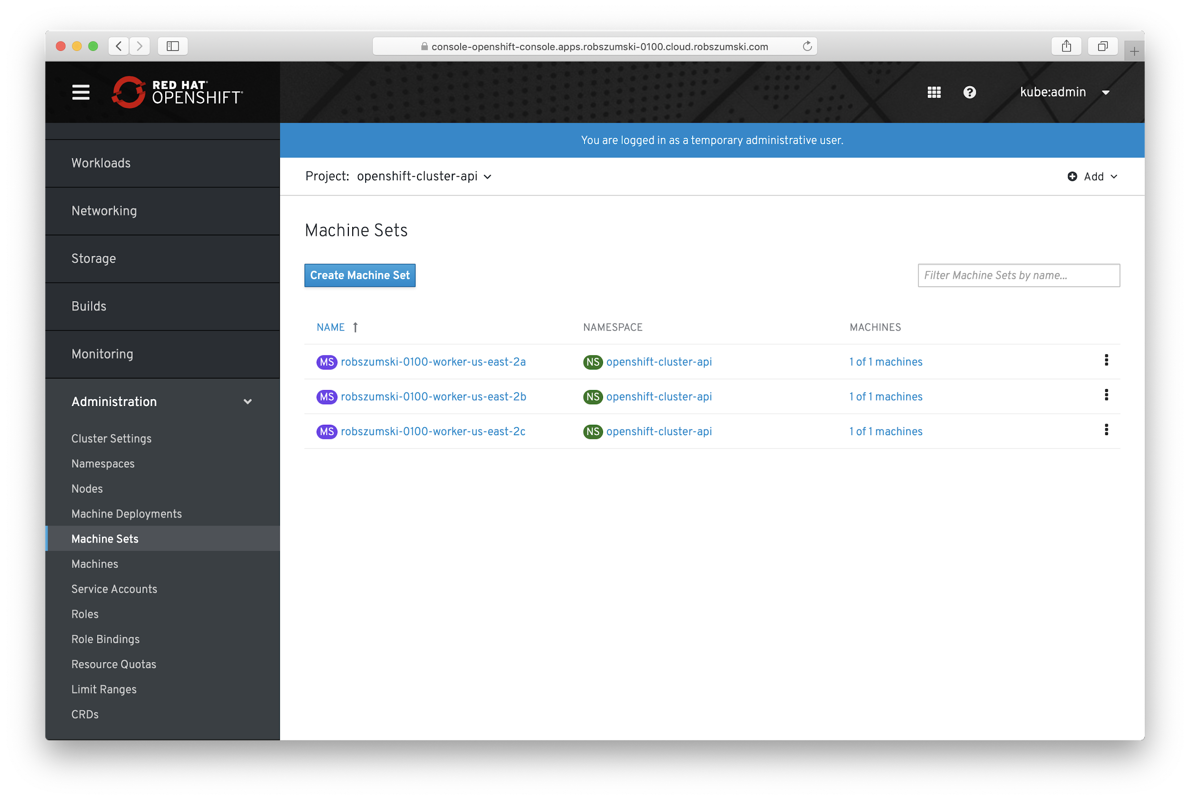

Slide 25
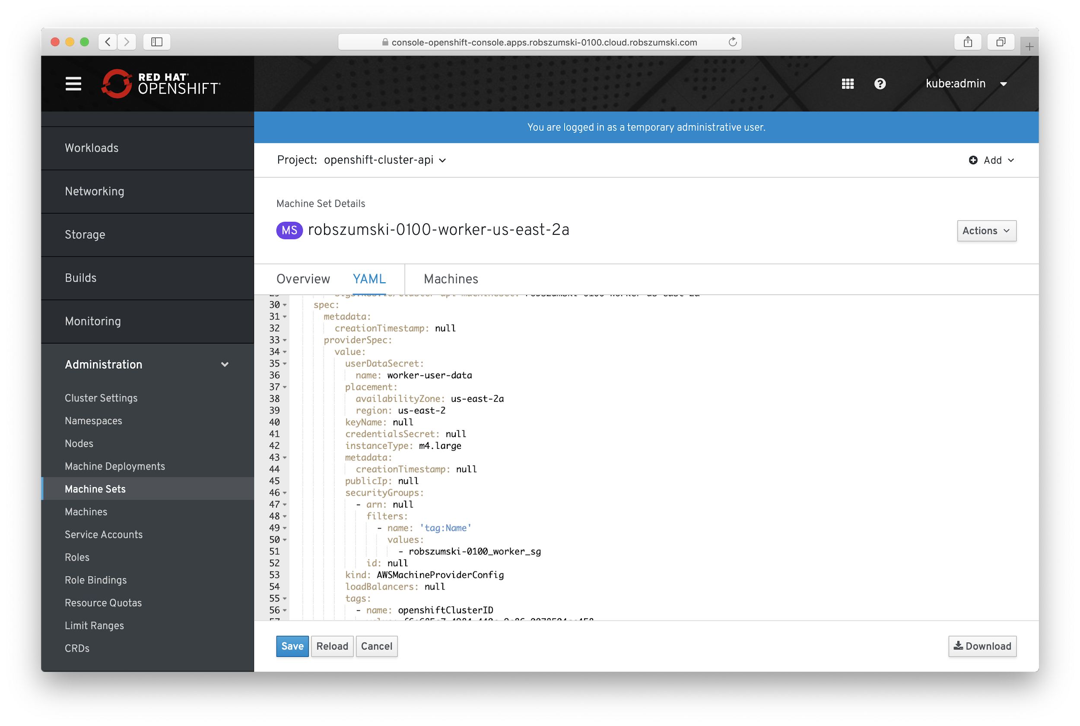

Slide 26
POSSIBLE CLUSTER ARCHITECTURE
Internet Traffic
Control Plane
m3.xlarge
Logging & Monitoring
r5.2xlarge
Load Balancer
Routing
m5.large
Workers
m5.large

Slide 27
CLUSTER ARCHITECTURE
Scale Deployments independently
Desired state managed by cluster
Autoscale is no effort at all
Rolling Machine config updates
Control Plane
MachineDeployment
type=worker
=
MachineDeployment
type=log-mon
Special GPU
MachineDeployment
=
Special security
MachineDeployment
MachineDeployment
type=router
=
Special $anything
MachineDeployment

Slide 28

DAY 2 OPERATIONS
Machine Operators
Cluster Operators
Update Operators

Slide 29
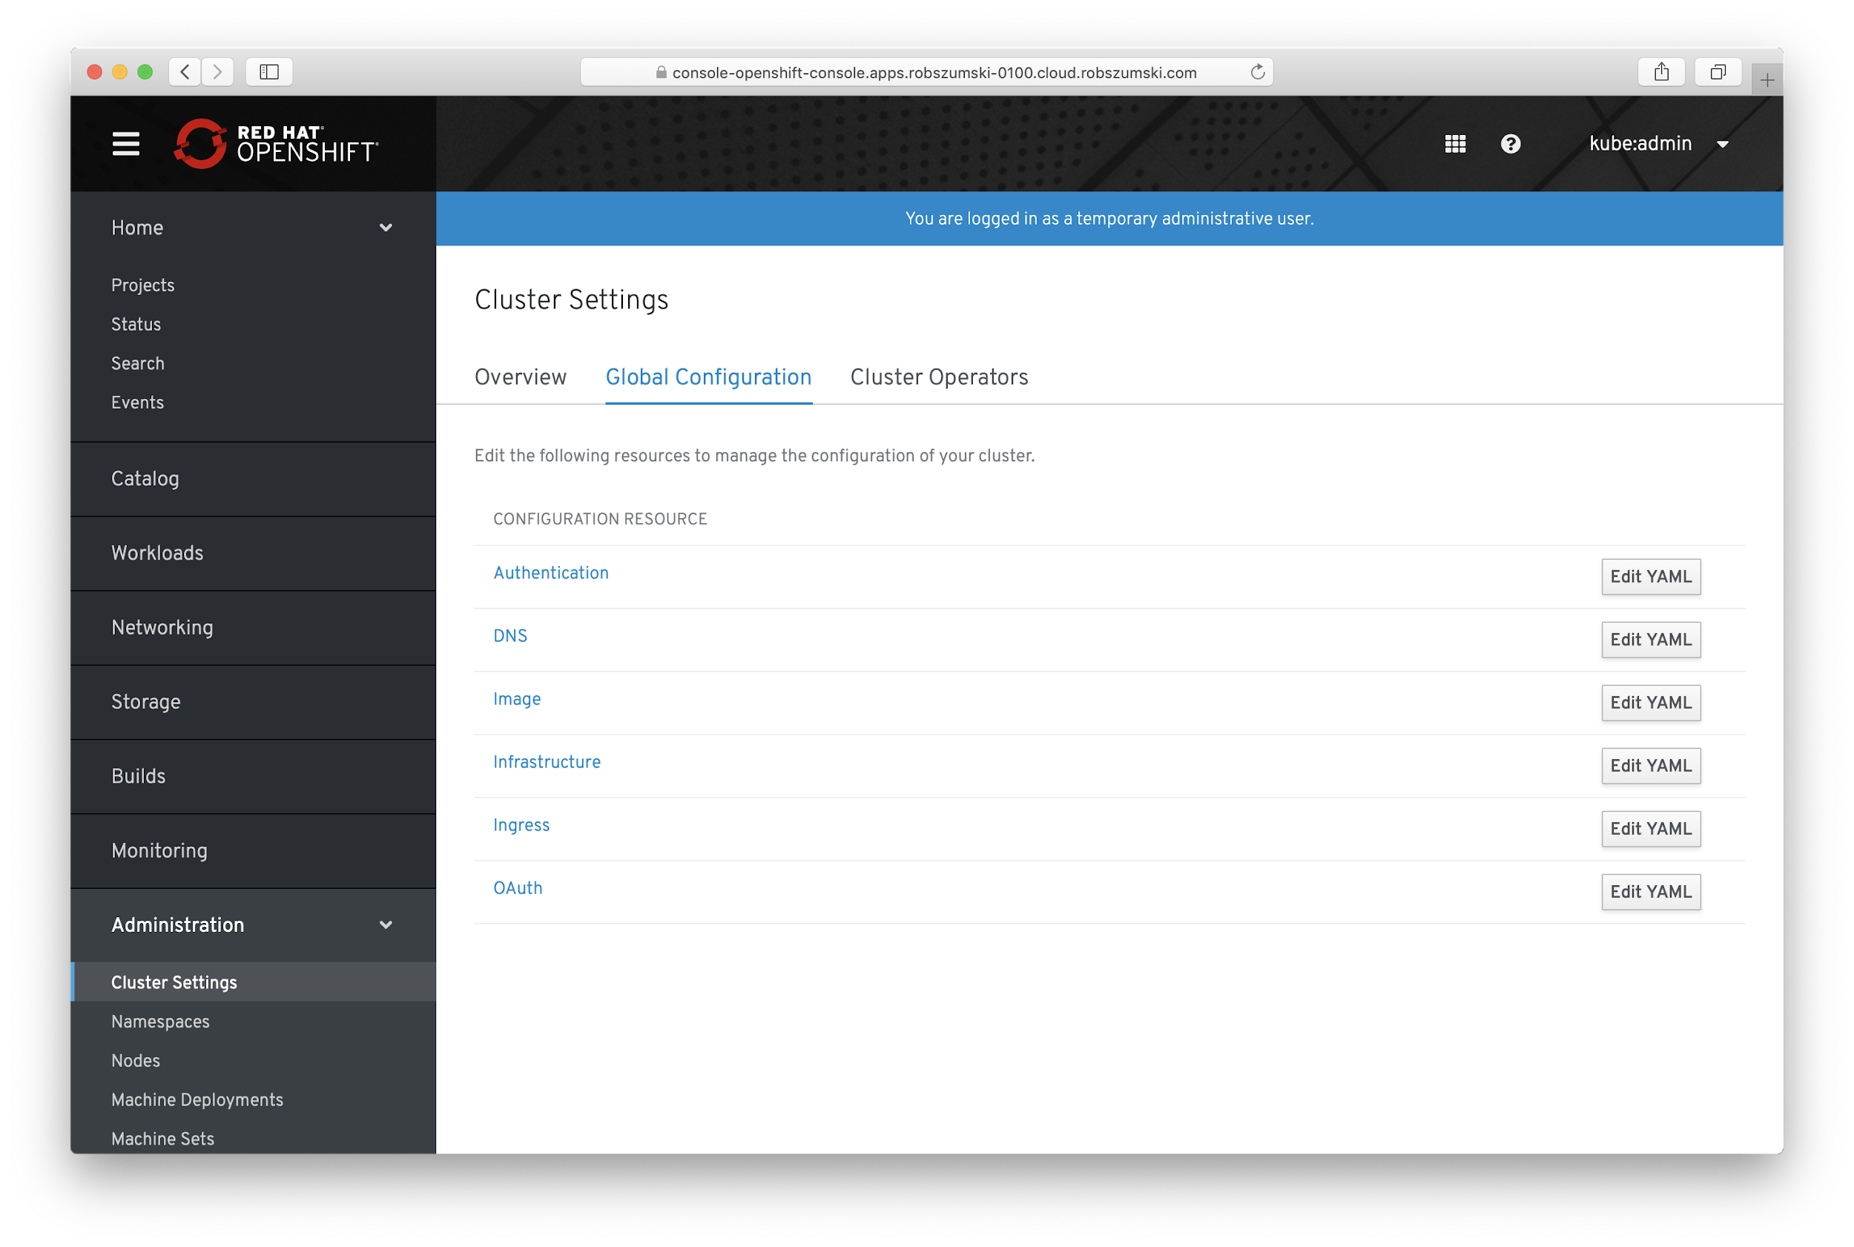

Slide 30
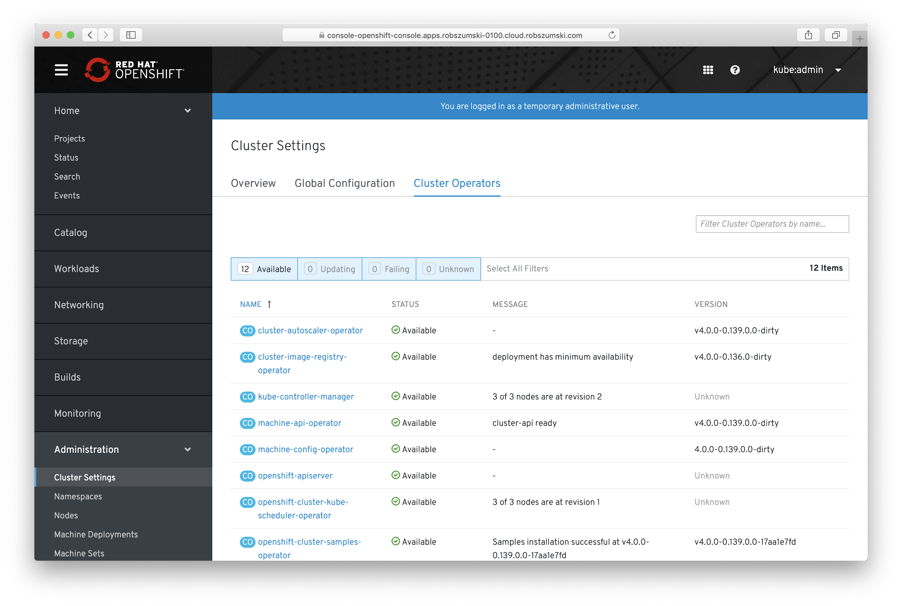

Slide 31
Thank you !

